Slide 1
Climate Change
Our commitments:
July 2019: Full Council unanimously declared a climate change emergency
Forms a key part of our Council Plan
Is a priority area in the Covid-19 Recovery Plan
£4m fund
Continual improvements. Environmental Management System (ISO14001)

Slide 2
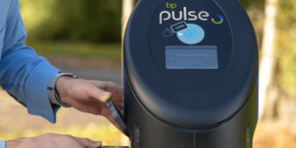
THEME 1: Enabling people and communities to reduce their carbon emissions
Solar together: a group buying scheme for solar PV and battery charging. Participating households benefit from benefit from lower than market rate pricing.
Now open for expressions of interest.
Expressions close 23 March. Reverse auction to contract an approved installer at the best price.
Supplier provides a costed recommendation – action by 21 May. Installations to end October 2021.
Switch and Save: 8th round. 1.2m households have already taken part and switched to a renewable energy tariff at a lower than market rate cost. Average saving per household: £232.
Green Shoots: £1 million community fund to support local schemes increase the adaptability and resilience of Warwickshire to the
effects of climate change, reduce
environmental impacts and benefit the wider Warwickshire community.
Electric vehicle charging points: We have secured £1m of external funding
to deliver over
180 electric
vehicle
charging points in 2021/2022.

Slide 3
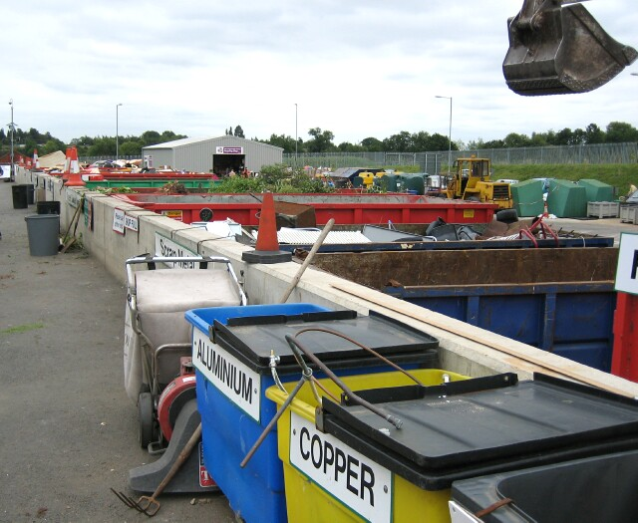
Safe and active travel for Schools: Safe and active travel award programme. Employed two support officers employed to assist schools with developing healthy lifestyles and sustainable transport.
Waste recycling facility Warwickshire:
9 centres across the county.
From Car batteries to Cartons to TVs and monitors.

Slide 4
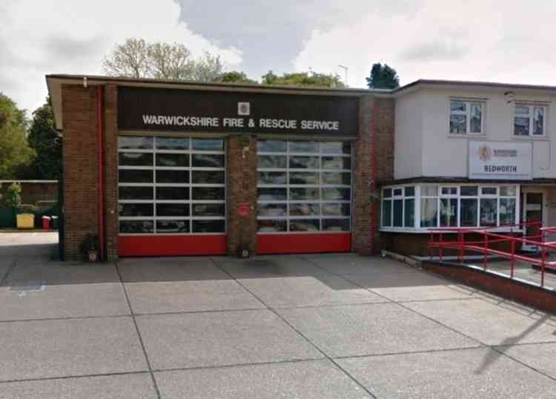
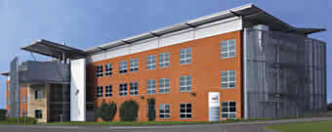
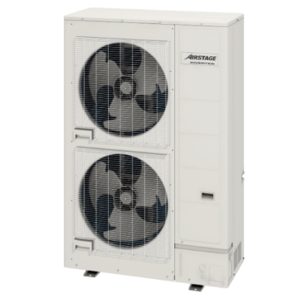
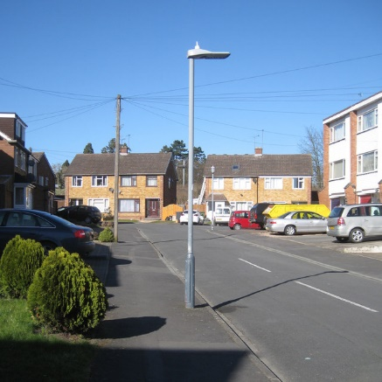
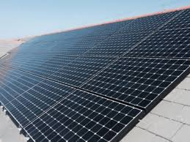
THEME 2: Decarbonising our own estate
All electricity from renewable sources
Public Sector decarbonisation scheme. Grant: £283,000
Low carbon skills fund. Funding for the development of long-term plan to reduce carbon emissions
Air source heat pump to be installed at Bedworth for station to replace aging boiler.
LED streetlights. An ongoing programme now means that 85% are LED.
Solar panel array to be installed at Elliot Park Innovation Centre.

Slide 5
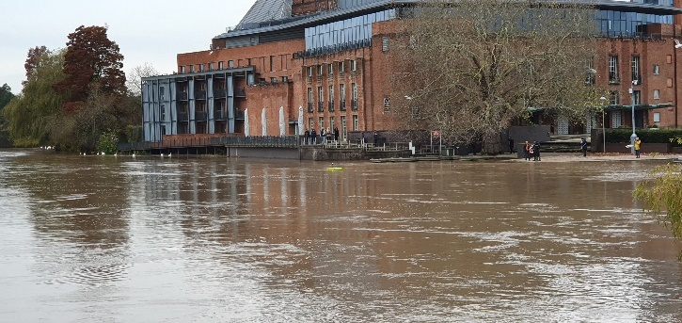
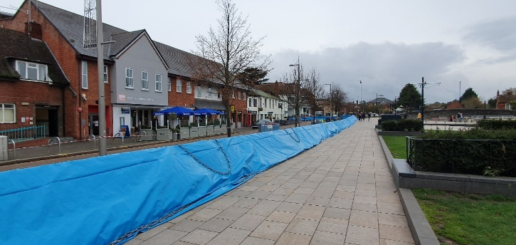
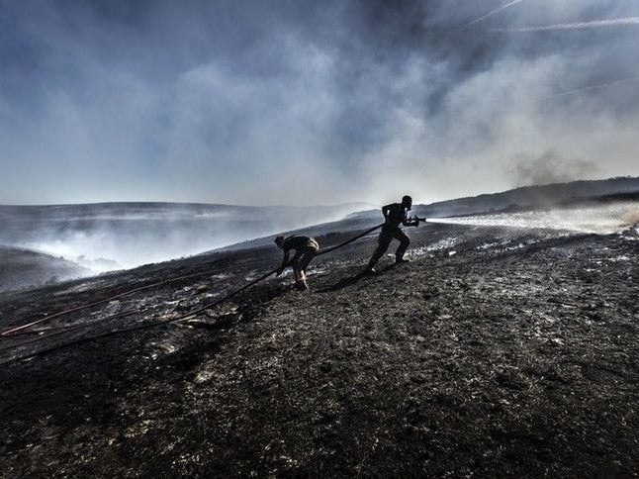
THEME 3: Planning for the future
Since 1884 all of the UK’s ten warmest years have occurred since 2002; whereas none of the ten coldest years have occurred since 1963.
Warwickshire has been working towards climate adaptation for the last decade.
Climate change impact assessment: We are developing plans to be prepared for future changes.
It will be necessary to build on existing strengths and partnerships to deal with an increasing number of more extreme events and longer term impacts of a changing climate across a vast array of our service areas.
Stratford flood Nov 2019
Stratford flood barriers Nov 2019: we dealt with it then.
Wildfires: 2017: Between May and July, the Warwickshire Fire and Rescue Service tackled 197 grass and wild fires as the summer’s soaring temperatures and weeks without rainfall turned grasslands into tinderboxes.

Slide 6
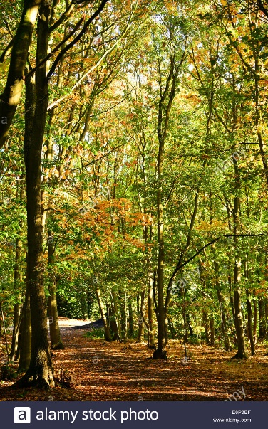
THEME 4: Much more to do
Plant a tree for every resident and increase biodiversity
Proceed with the installation of several large-scale ground mounted solar PV arrays
How we work. Agile working. Consolidate change in behaviours as a result of Covid-19
Business. Safe and Active Travel (SAfER) for employers
Develop a new waste strategy
Transport. Update the current Local Transport Plan (LTP), which is a document that sets out the transport needs, challenges, priorities and objectives for the county
Tackle emissions from our own fleet
Sustainable procurement

